Slide 1


Computer Fundamentals
ACROPOLIS
Enlightening wisdom
Submitted To:
Prof. Mahendra Verma
Submitted By:
Tanay Patil
CS-04
0827cs211241

Slide 2

Introduction to Web Developement
Using HTML

Slide 3
What is HTML?
HTML stands for Hyper Text Markup Language
HTML is the standard markup language for creating Web pages
HTML describes the structure of a Web page
HTML consists of a series of elements
HTML elements tell the browser how to display the content
HTML elements label pieces of content such as "this is a heading", "this is a paragraph", "this is a link", etc.

Slide 4

What is an HTML Element?
An HTML element is defined by a start tag, some content, and an end tag:
<tagname>Content goes here...</tagname>
The HTML element is everything from the start tag to the end tag:
<h1>My First Heading</h1>
<p>My first paragraph.</p>
Start tag | Element content | End tag
<h1> | My First Heading | </h1>
<p> | My first paragraph. | </p>
<br> | none | none

Slide 5
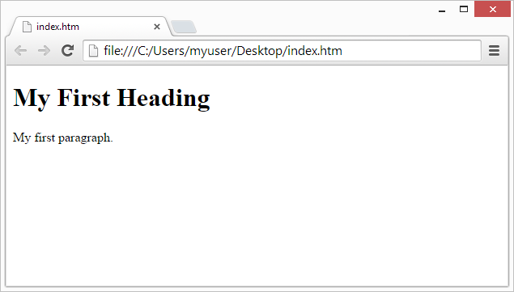
Web Browsers:
The purpose of a web browser (Chrome, Edge, Firefox, Safari) is to read HTML documents and display them correctly.
A browser does not display the HTML tags, but uses them to determine how to display the document:

Slide 6
HTML Page Structure:
Below is a visualization of an HTML page structure:
<html>
<head>
<title>Page title</title>
</head>
<body>
<h1>This is a heading</h1>
<p>This is a paragraph.</p>
<p>This is another paragraph.</p>
</body>

Slide 7
HTML History:
Since the early days of the World Wide Web, there have been many versions of HTML:
Year | Version
1989 | Tim Berners-Lee invented www
1991 | Tim Berners-Lee invented HTML
1993 | Dave Raggett drafted HTML+
1995 | HTML Working Group defined HTML 2.0
1997 | W3C Recommendation: HTML 3.2
1999 | W3C Recommendation: HTML 4.01
2000 | W3C Recommendation: XHTML 1.0
2008 | WHATWG HTML5 First Public Draft
2012 | WHATWG HTML5 Living Standard
2014 | W3C Recommendation: HTML5
2016 | W3C Candidate Recommendation: HTML 5.1
2017 | W3C Recommendation: HTML5.1 2nd Edition
2017 | W3C Recommendation: HTML5.2

